Slide 1
Smart Pointer
Introduction
Why
What
How to use
Mistake to avoid
Hanoi, May 2019

Slide 2
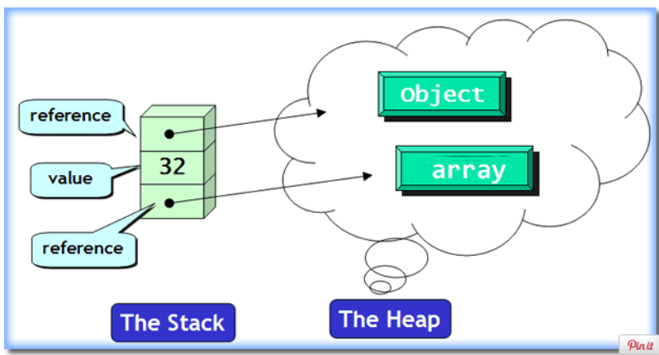
Introduction
Memory allocation

Slide 3
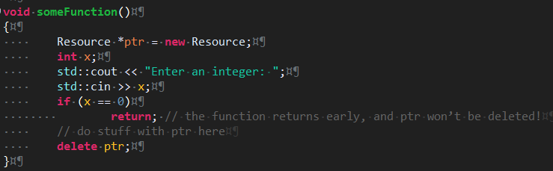
Why?
Management memory is painful of C++

Slide 4
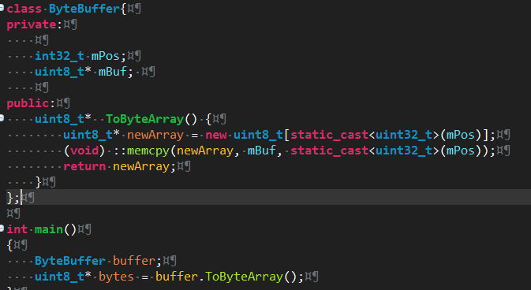
Why?
Who will delete the bytes pointer ?

Slide 5
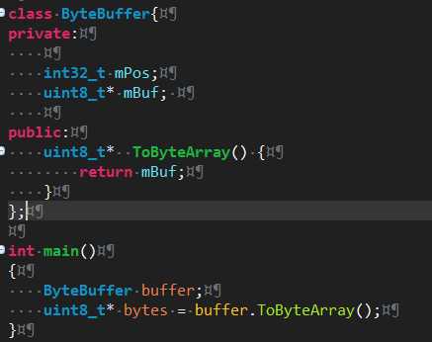
Why?
=> Who will delete the bytes pointer ?

Slide 6
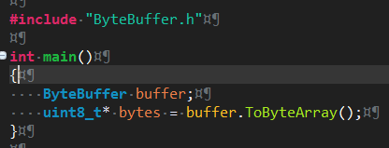
Why?
In case of we just have header file ByteBuffer.h
The ByteBuffer.cpp was packed in the lib file. It is impossible to read
=> Who will delete the bytes pointer ?

Slide 7
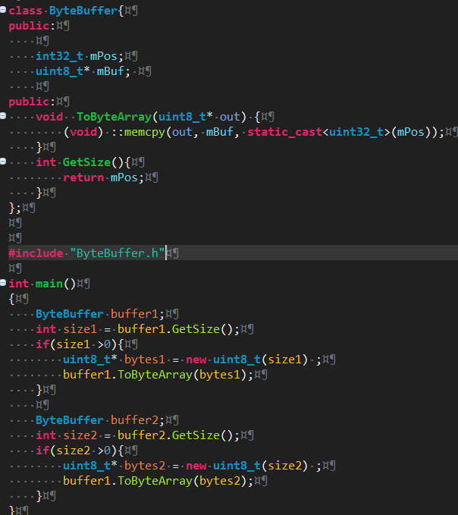
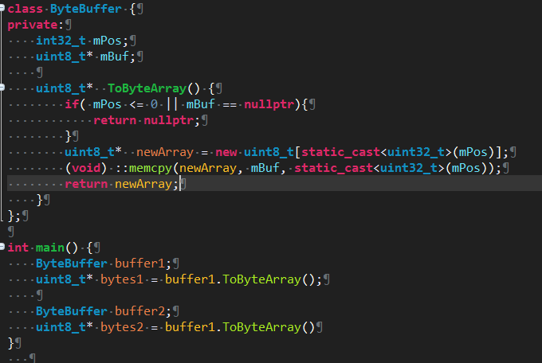
Why?
Define the API using parameter out:
It makes inconvenient to use API
Break the rule: F.20: For "out" output values, prefer return values to output parameters
(https://github.com/isocpp/CppCoreGuidelines/blob/master/CppCoreGuidelines.md#Rf-out-multi
Parameter out
Return value

Slide 8
Why?
Recommendation: Prefer smart pointers to raw pointers. Smart pointers can do virtually everything raw pointers can, but with far fewer opportunities for error according to
Effective Modern C++ [Book] - O'Reilly Media
https://www.oreilly.com/library/view/effective-modern-c/9781491908419/ch04.html

Slide 9
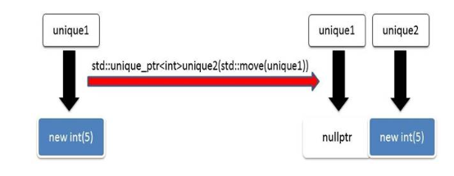
What ?
Unique pointer:
An std::unique_ptr is by design as fast and as slim as a raw pointer but has a great benefit: it automatically manages its resource.
Use move an std::unique_ptr to transfer owner
Can not copy/assign

Slide 10
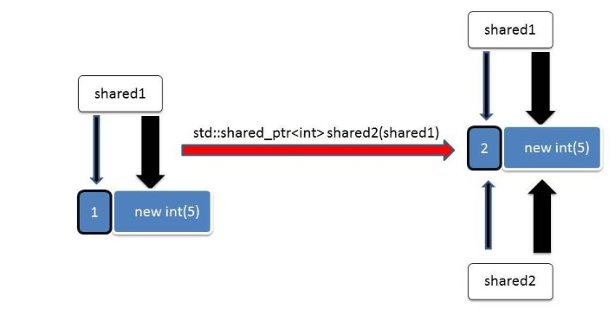
What?
Shared pointer:
Unlike std::unique_ptr, which is designed to singly own and manage a resource, std::shared_ptr is meant to solve the case where you need multiple smart pointers co-owning a resource..
As soon as the last std::shared_ptr managing the resource goes out of scope (or is reassigned to point at something else), the resource will be deallocated.
Can copy/assign

Slide 11
What?
Sematic of pointers
Type | Description
References | I'm not the owner. I only borrow the resource that cannot be empty
Raw pointers | I'm not the owner. I only borrow the resource that can be can be empty. I must not delete the resource.
std::unique_ptr | I'm the exclusive owner of the resource. I may explicitly release the resource.
std::shared_ptr | I share the resource with other shared ptr. I may explicitly release my shared ownership

Slide 12

What?
Performance :
The program allocates and deletes 100.000.000 ints

Slide 13

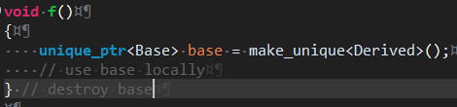
How to use
Point 1 | Prefer unique_ptr over shared_ptr unless you need to share ownership
Reason | A unique_ptr is conceptually simpler and more predictable (you know when destruction happens) and faster (you don’t implicitly maintain a use count).
Bad example
Good example

Slide 14
How to use
Point 2 | Use make_shared() to make shared_ptr
Reason | std::make_shared() is simpler and safer (there’s no way to directly create two std::shared_ptr pointing to the same resource using this method) std::make_shared() is also more performant than not using it. The reasons for this lie in the way that std::shared_ptr keeps track of how many pointers are pointing at a given resource.
Good example | std::shared_ptr<int> foo = std::make_shared<int> (10);

Slide 15
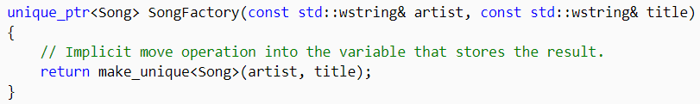
How to use
Point 3 | Use make_unique () to make unique_ptr
Reason | For convenience and consistency with shared_ptr Code using std::make_unique is simpler and simpler and safer
Good example

Slide 16
Mistake to avoid
Point 1 | Using a shared pointer where an unique pointer suffices !!
Reason | Subtle Bugs: Just imagine if you never imagined a scenario where the resource is shared out by some other programmer by assigning it to another shared pointer which inadvertently modifies the resource ! A shared_ptr needs to maintain the thread safe refcount of objects it points to and a control block under the covers which makes it more heavyweight than an unique_ptr.
Recommendation | By default, you should use a unique_ptr. If a requirement comes up later to share the resource ownership, you can always change it to a shared_ptr.

Slide 17
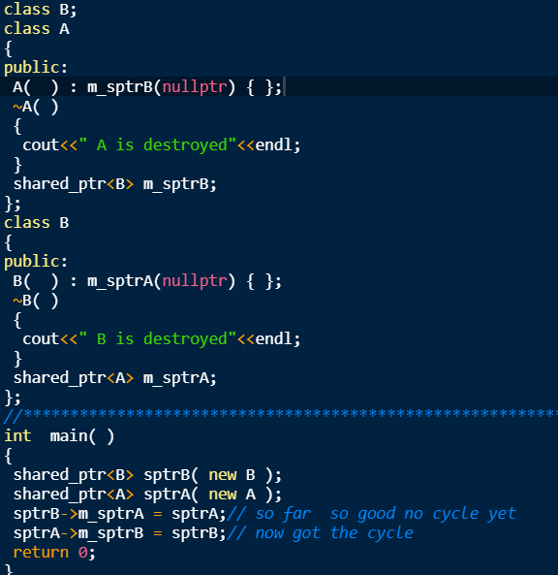
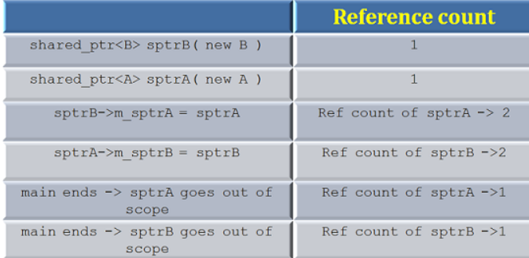
Mistake to avoid
Point 2 | Not avoiding cyclic references when using shared pointers
Example
Reason | we got a cycle - neither maverick nor goose will ever be destroyed
Solution | Using std::weak_ptr to m_sptrB and m_sptrA solve this problem

Slide 18
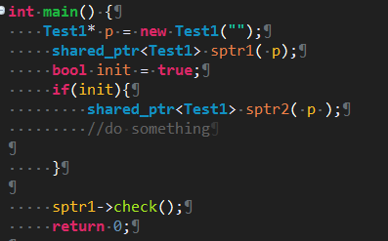
Mistake to avoid
Point 3 | Crash!!!
Example
Reason | P object already release before calling sptr1->check()

Slide 19
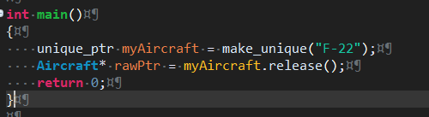
Mistake to avoid
Point 4 | Not deleting a raw pointer returned by unique_ptr.release()
Example
Reason | Releases ownership of its stored pointer, by returning its value and replacing it with a null pointer. The Release() method does not destroy the object managed by the unique_ptr, but the unique_ptr object is released from the responsibility of deleting the object. Someone else (YOU!) must delete this object manually

Slide 20
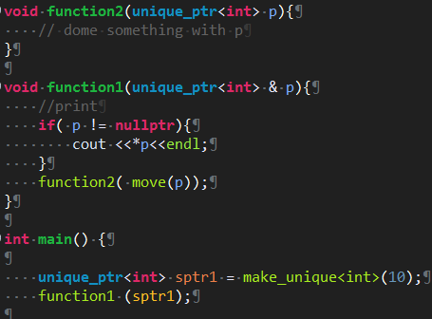
Code review example

Slide 21
Reference
https://stackoverflow.com/questions/1825964/c-c-maximum-stack-size-of-program
https://www.modernescpp.com/index.php/c-core-guidelines-rules-to-smart-pointers
https://www.learncpp.com/cpp-tutorial/15-5-stdunique_ptr/
https://www.oreilly.com/library/view/effective-modern-c/9781491908419/ch04.html
https://github.com/isocpp/CppCoreGuidelines/blob/master/CppCoreGuidelines.md

